Slide 1
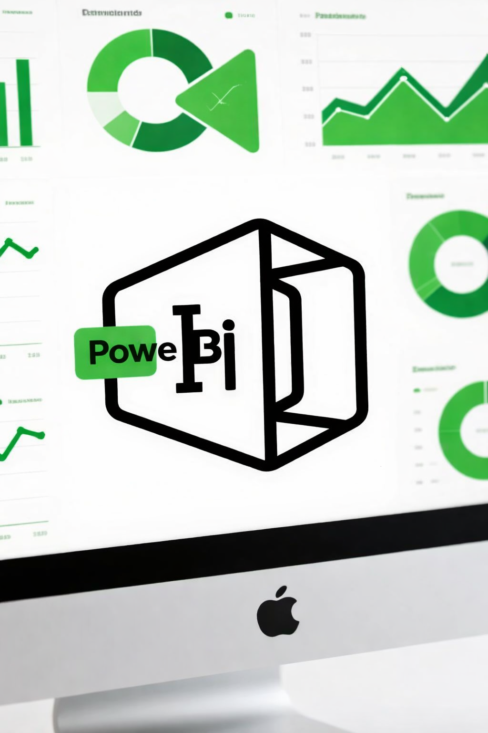

Introduction to
Microsoft Excel
Batch-19

Slide 2





About the Trainer
Name : Engr. Mir Masud Uz Zaman
Education : B.Sc. in EEE, KUET
Profession : Manager, Corporate - Sales Omera Petroleum Limited.
Training Certifications :
Certified Microsoft Office Specialist – Expert
Computer Operation Level – 3 Competent.
NSDA Certified Trainer and Assessor
CBT&A Level – 4 Competent

Slide 3





Certifications

Slide 4




Why Data Matters in Modern Business
In today's competitive landscape, data is more than just numbers; it's the lifeblood of informed decision-making and strategic advantage.
Competitive Edge
Informed Decisions
Growth Opportunities
Identify market gaps and outperform rivals.
Move beyond guesswork with evidence-based strategies.
Uncover new revenue streams and customer segments.

Slide 5





Components of a Data Analyst
Data analytics transforms raw data into actionable intelligence, guiding businesses through complex challenges and towards strategic success.
Data Collection
Gathering relevant information from various sources.
Data Processing
Cleaning, transforming, and organizing data.
Analysis & Modeling
Applying techniques to find patterns and insights.
Actionable Insights
Translating findings into strategic business moves.

Slide 6
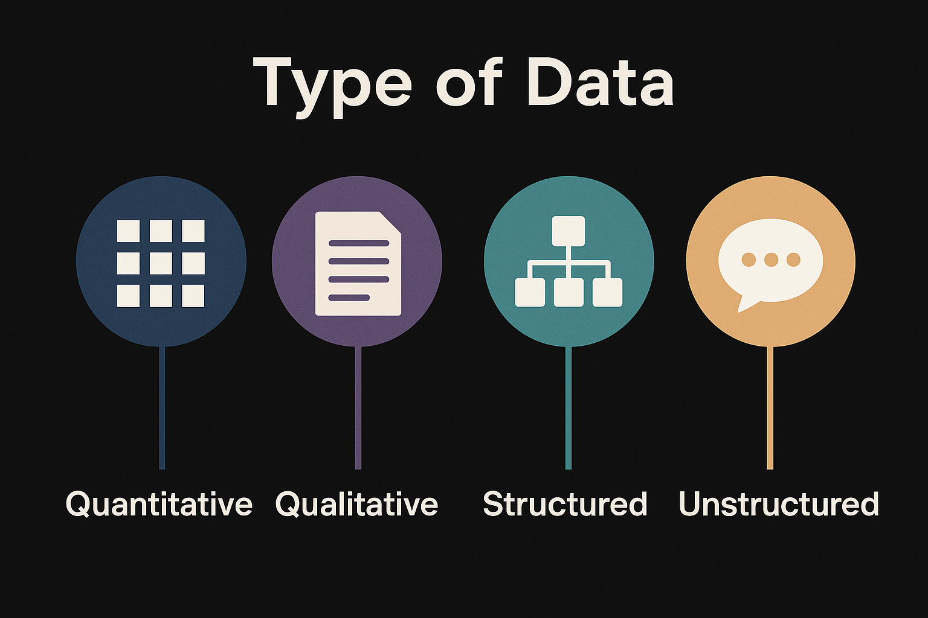
Understanding Data Analytics: Types & Levels
Types of Data
Levels of Analytics
Quantitative: Numerical data, easily measured and compared (e.g., sales figures, stock prices).
Qualitative: Descriptive data, offering insights into motivations and opinions (e.g., customer feedback, survey responses).
Structured: Organized in a defined format (e.g., databases, spreadsheets).
Unstructured: Raw, unorganized data (e.g., emails, social media posts, videos).
Prescriptive
What should we do?
Predictive
What will happen?
Diagnostic
Why did it happen?
Descriptive
What happened?

Slide 7
Tools of the Trade: What Every Data Analyst Needs
From wrangling raw data to crafting compelling visuals, these are the essential tools that power modern data analysis. Mastering this toolkit will set you apart in today's data-driven job market.
Programming
Databases
Visualisation
Python & R — the backbone of data analysis, from cleaning data to building predictive models.
SQL, MySQL & PostgreSQL — query and manage structured data at any scale.
Tableau & Power BI — turn numbers into clear, interactive stories for any audience.
Spreadsheets
Power Tools
Excel & Google Sheets — still indispensable for quick analysis, pivots, and collaboration.
Jupyter Notebook for exploratory analysis; Apache Spark for large-scale, distributed data processing.

Slide 8



Scope of a Data Analyst
Data analytics is one of the fastest-growing career fields globally — spanning industries and evolving rapidly into specialised roles.
Business Analyst
Data Scientist
Data Engineer
Bridges the gap between data and business decisions, translating insights into strategy.
An advanced path focused on predictive modelling, machine learning, and statistical research.
Designs and maintains the infrastructure that makes data accessible and reliable.
🖥 IT
🏦 Banking
Software, cybersecurity, cloud platforms
Risk analysis, fraud detection, lending
🏥 Healthcare
🛒 Retail
Patient outcomes, clinical research
Consumer behaviour, supply chain

Slide 9

The Future of Data Analytics
The field is evolving at an extraordinary pace — and those who upskill today will lead tomorrow.
1
AI & Machine Learning
Predictive algorithms are becoming standard tools in every analyst's toolkit.
2
Big Data Expansion
Data volumes are growing exponentially, requiring new skills in distributed computing and cloud storage.
3
Analytics Automation
Routine reporting and data preparation tasks are increasingly handled by automated pipelines.
4
Surging Demand
Data roles consistently rank among the most in-demand and highest-paid professions worldwide.

Slide 10
Challenges in Data Analytics
Every rewarding career comes with real obstacles. Understanding these challenges helps you prepare and grow stronger.
🔒 Data Privacy
✅ Data Quality
Analysts must navigate regulations like GDPR and handle sensitive data responsibly.
Real-world data is rarely clean — spotting and fixing errors is a core skill.
📦 Large Datasets
📚 Continuous Learning
Managing high-volume data requires the right tools and efficient thinking.
The landscape shifts constantly — curiosity and adaptability are non-negotiable.

Slide 11


Must-Have Skills for
Data Analysts
Analytical Thinking
Problem-solving and critical evaluation of data.
Communication
Translating complex insights into clear narratives.
Business Acumen
Understanding business context and objectives.
Statistical Knowledge
Applying statistical methods for robust analysis.

Slide 12
What is Microsoft Excel ?

Slide 13
What is Microsoft Excel ?
Microsoft Excel is a software program used to organize, calculate, and analyze data in a spreadsheet format.
Spreadsheet Format
Cell → single box (e.g., A1)
Worksheet → one sheet
Workbook → entire Excel file (multiple sheets)
Organize Data
Sorting (A→Z, highest to lowest)
Filtering (show only specific data)
Tables & formatting (colors, borders)
And Many More…
And Many More…
Calculate Data
No need to calculate manually
Results update automatically when data changes
Supports complex math, finance, and statistics
Analyze Data
Charts & graphs (bar, pie, line)
Pivot Tables (summarize large data quickly)
Conditional formatting (highlight trends)
And Many More…
And Many More…

Slide 14
Thank You learners..
Let's explore Microsoft Excel.

